Slide 1
Payroll Interface Training
Conference ID: 3 357 828 830
US & Any Country - Toll Call: +1-615-882-6682
US & Canada - Toll-free: +1-844-882-6682
Other local & International Numbers https://dialin.deloitte.com/
Host: Dan Fieldhouse - dfieldhouse@deloitte.com
1
Notes:
Third-Party Payroll Connectors allow you to manage payroll-related Human Resources data and send it to a third-party payroll provider. Worker synchronization, data changes, and worker events relevant to the payment process are configured so that appropriate next steps can be taken in the payroll system.
The advantage of these connectors is the relative ease-of-use and full set of integration features that require no custom code (though the interface is extensible if needed). With change detection built-in, the connector is configured by simply selecting which data and events are required by the accepting payroll system. The interface is pre-tested and supported by Workday, which means less development and testing for your implementation, reduced maintenance costs and risks to the project.

Slide 2
Cloud Connect for Third-Party Payroll Training
Agenda
Day 1 Overview Payroll Interface Setup Payroll Interface Example
Day 2 Staffing Events & Change Detection Functional Changes & PI
Day 3 Payroll Effective Change Interface (PECI) Functional Changes & PECI
Day 4 / Day 5 (if needed) Comparing PI to PECI Transformation & Delivery Wrap Up
Notes:
Course Overview

Slide 3
Comparing PI to PECI

Slide 4
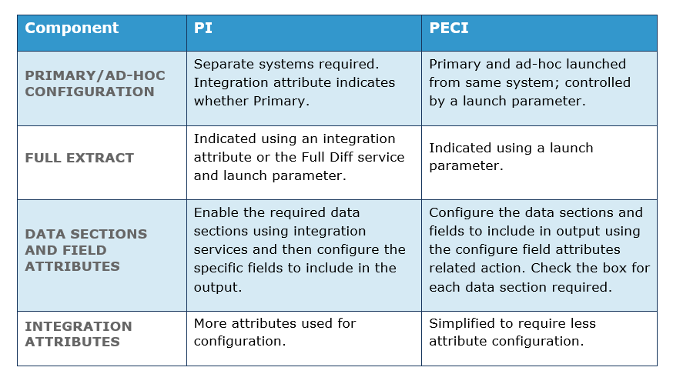
PI vs PECI
Notes:
updated

Slide 5
PI vs PECI
CHANGE DETECTION
PI requires that the Change Detection Launch Parameters integration service be configured in order for change detection to occur. Change Detection launch parameters are automatically available for PECI.
PECI has a limit on the Last Successful Run date applied: ad-hoc is 6 months; primary is 2 months.
The Transaction Log service is recommended for PI integrations while it is not recommended for PECI, except on an ad-hoc basis, to pick up a specific set of events.
The change detection method applied for PI and PECI is the same. Both templates consider the entry date of the change in relation to the last successful run date, along with the change detection method applied. However, the data included in the output may differ because PI is limited to including data changes from the top of the stack, while PECI reports each effective change in the stack.
Notes:
updated

Slide 6
PI vs PECI
Indirect Changes
PECI: when the transaction log is turned off. For example, a change to a cost center name is reported.
PI: Indirect changes are not reported.
Correction and Rescind Support PECI: certain staffing event codes are handled directly in output XML.
PI: Limited; separate corrections & rescinds report.
Output Files PECI: Separate files tagged by Pay Group.
PI: Single consolidated file containing data for all Pay Groups.
Notes:
updated

Slide 7
PI vs PECI
DFOs
PECI: No additional service required
PI: Field override service required
Pay Group Size
PECI: 90,000 workers per pay group
PI: Unlimited Abort
PECI: Running process can be aborted
PI: Aborting a current run is not supported
Notes:
updated

Slide 8
PI vs PECI
Frequency
PECI: Recommended to not be run more than once per day
PI: Can be run multiple times a day Migration
PECI: Must be migrated using Object Transporter (OX)
PI: Can be migrated using iLoad
Time Tracking
PECI: Not supported
PI: Supported
Notes:
updated

Slide 9
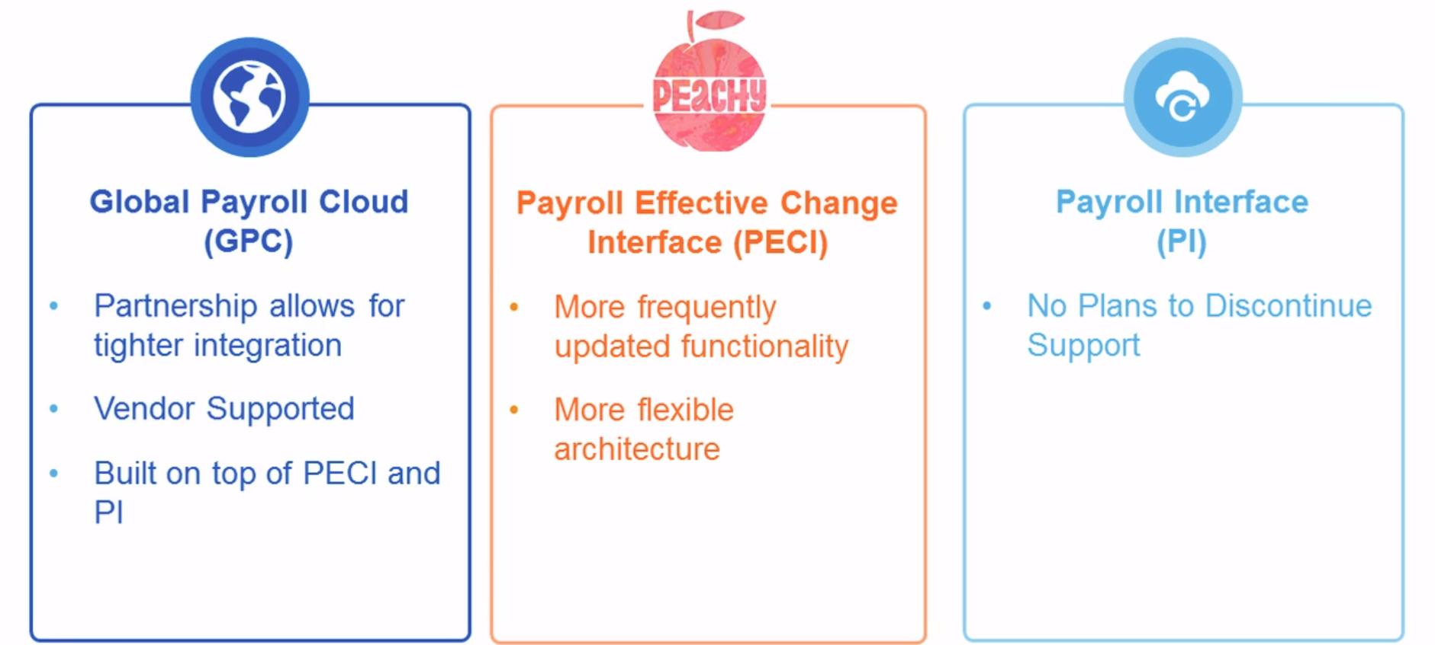
Deciding on PI vs PECI
Notes:
updated

Slide 10
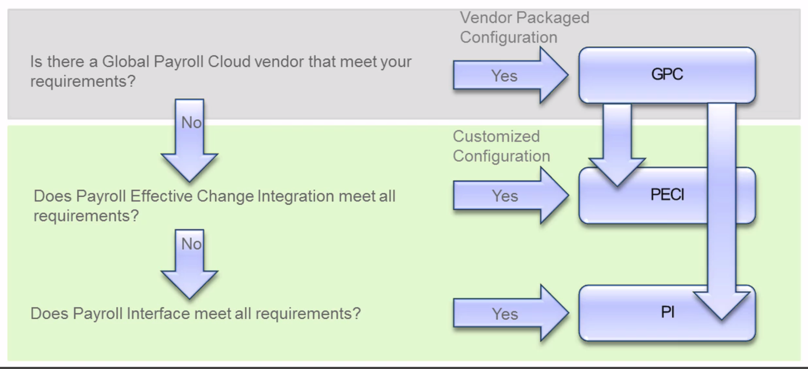
Deciding on PI vs PECI
Notes:
updated

Slide 11
Processing Payroll Interface Transformation Options

Slide 12
Choosing Transformation Tool
Document Transformation is recommended as the first choice. Only use Studio if a requirement hits one of DT’s feature limitations. The primary reasons for choosing DT is that it is a simpler, more efficient, and flexible solution.
Simpler- All you need is a text editor to write an XSLT code to build the transformation.
Efficient- Allows up to 16GB of very efficient, in-memory data processing, as opposed to a lower 2GB limit for Studio.
Flexible- Allows you to set it up to deliver to multiple end-points with a dynamic file name for output files in a different file layout.
In some cases, DT won’t meet the requirements of the customer and Workday Studio will need to be used instead of DT. Here are some real use case examples of when Studio may be necessary.
Multiple data sources
Merging output files
Dynamic end point/folder destination, depending on content
Dynamic file name text
Logic complexity
Chunk out, split, and merge data
Complex error handling
Notes:
updated

Slide 13
Document Transformation
Element Transformation and Validation (ETV) and XML To Text (XTT) enable you to add Workday-specific processing instructions to an XSLT file's elements using attributes. After adding the XSLT file that generates XML with ETV and/or XTT attributes to a Document Transformation integration system, Workday applies transformations and validations to the integration system's output documents.
ETV and XTT provide a number of different ways to transform and validate elements in an XML document. Document Transformation can output XML, Comma Separated Value (CSV) Formatting, or Fixed Length Formatting.
Pros:
Has efficient In-Memory processing
Can handle large data size
Uses XSLT as foundation
Has short-cut XSLT extensions for frequently used transformations
Is simpler than Studio
Can be configured to deliver output to multiple end-points
Notes:
updated

Slide 14
Workday Studio
Workday Studio is a tool aimed at skilled developers and offered as a set of plug-ins to the Eclipse IDE. Workday Studio offers a rich, graphical development environment in which a user can drag and drop a variety of reusable components that handle the “plumbing” aspects of integration building, freeing you to focus on the critical business logic.
Pros:
Can handle complex multi-step processing logic
Can handle processing of data derived from multiple sources
Can deliver output to multiple end-points with complex file naming requirements
Notes:
updated

Slide 15
PECI Merge File Integration
You can merge the output files of the Payroll Effective Change Interface connector to send a single file to your third-party payroll vendor, instead of one file for each pay group.
To merge the files, your Payroll Effective Change Interface connector uses a business process to call a separate merge file integration. This integration is called repeatedly until all the pay groups are processed. The merged output file is attached to the last process call to the merge integration.
Notes:
updated

Slide 16
Processing Payroll Interface Output

Slide 17
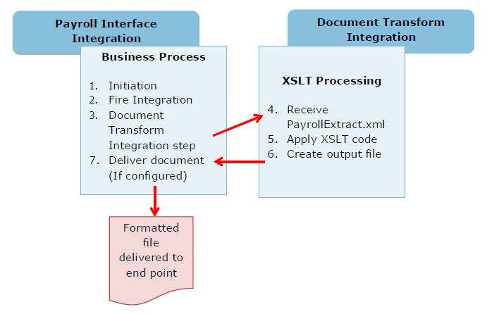
Document Transformation for PI
Notes:
updated

Slide 18
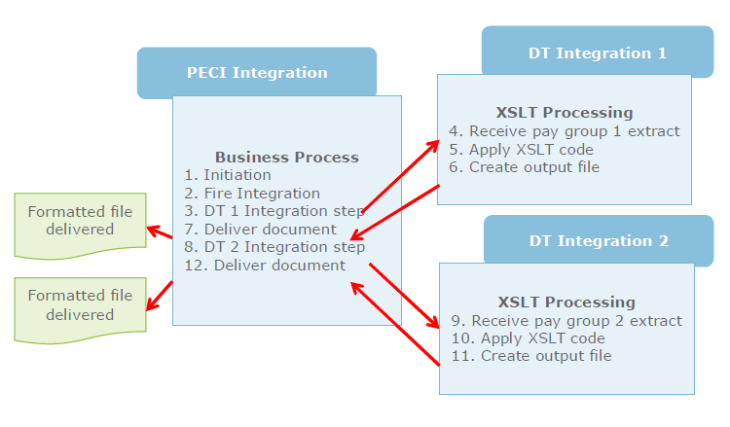
Document Transformation for PECI
Notes:
updated

Slide 19
Inbound Payroll Results Integration

Slide 20
Inbound Payroll Results Integration
Integration Process Flow
The integration imports payroll results lines:
External payroll endpoint generates a payroll results file and sends it to a location known to the integration.
Launch the integration.
Integration retrieves the file according to the Document Retrieval configuration on the Integration Process Event.
Integration processes each row. Integration removes erroneous records and returns error messages to the integration event. The integration imports valid records and applies a single batch ID (if you don't specify a batch ID).
You can correct and resubmit the erroneous records manually.
Notes:
updated

Slide 21
Inbound Payroll Results Integration
Column Name
Batch_ID
Pay_Group
Period_End_Date
Payment_Date
Pay_Group_Currency_ID
Delete_Result
Employee_ID
Position_ID
Company_ID
Company_Currency_ID
Payment_Date
Check_Number
Gross_Amount
Net_Amount
Code
Earning_or_Deduction
Recorded_Currency_ID
Amount
Hours
Rate
Amount_in_Company_Currency
Amount_in_Pay_Group_Currency
Notes:
updated

Slide 22
Inbound Payroll Results Integration

Slide 23
Import External Payslips Integration
Import External Payslips integration imports employee payslips from an external third-party endpoint into Workday.
Integration Process Flow
External endpoint generates payslip files and sends files to an FTP server.
Integration retrieves payslip files from FTP server. You can set up a schedule to launch the integration, or launch the integration manually.
Integration imports payslips into Workday.
Notes:
updated

Slide 24
Import External Payslips Integration
Column Name
Worker
Pay_Group
Pay_Period_End_Date
Payment_Date
Net_Amount
Gross_Amount
Currency
Check_Number
Display_Date
File_Name
Notes:
updated

Slide 25
Additional Notes

Slide 26
Notes
WD30: Data Change audit reports is enhanced to support the Workday Standard Report
WD30: Inbound pay results integration expanded to support 75 unique earnings and deduction codes
Notes:
updated

Slide 27
Questions

Slide 28

About Deloitte Deloitte refers to one or more of Deloitte Touche Tohmatsu Limited, a UK private company limited by guarantee (“DTTL”), its network of member firms, and their related entities. DTTL and each of its member firms are legally separate and independent entities. DTTL (also referred to as “Deloitte Global”) does not provide services to clients. Please see www.deloitte.com/about for a detailed description of DTTL and its member firms. Please see www.deloitte.com/us/about for a detailed description of the legal structure of Deloitte LLP and its subsidiaries. Certain services may not be available to attest clients under the rules and regulations of public accounting. Copyright © 2016 Deloitte Development LLC. All rights reserved. 36 USC 220506 Member of Deloitte Touche Tohmatsu Limited

